Slide 1

ECE 281 GR 1 Review
Maj Jeffrey Falkinburg USAFA/DFEC
Room 2E46E 333-9193
1

Slide 2
Number Systems Expanded Normal Form
Decimal numbers
Binary numbers
Copyright © 2007 Elsevier

Slide 3
Number Systems
Decimal numbers
Binary numbers
Copyright © 2007 Elsevier

Slide 4
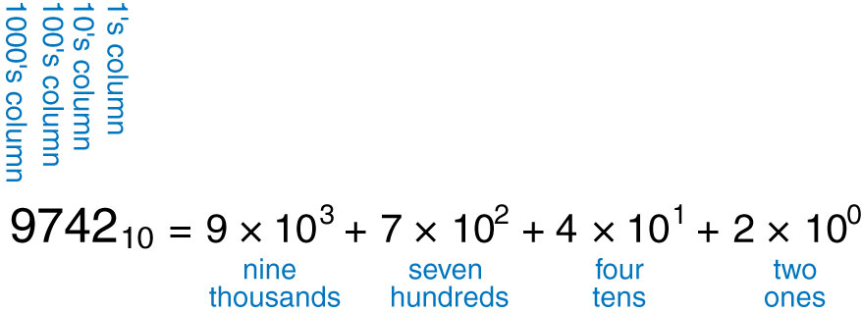
Figure 1.4 Representation of a decimal number

Slide 5
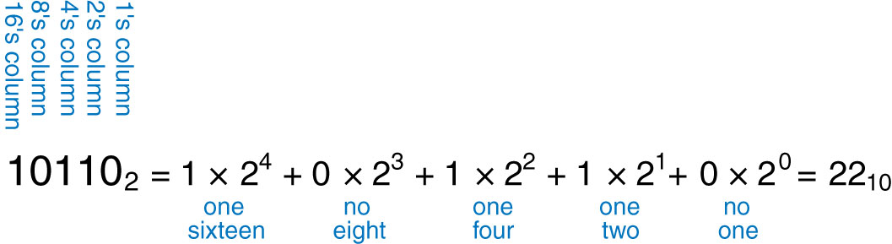
Figure 1.5 Conversion of a binary number to decimal

Slide 6
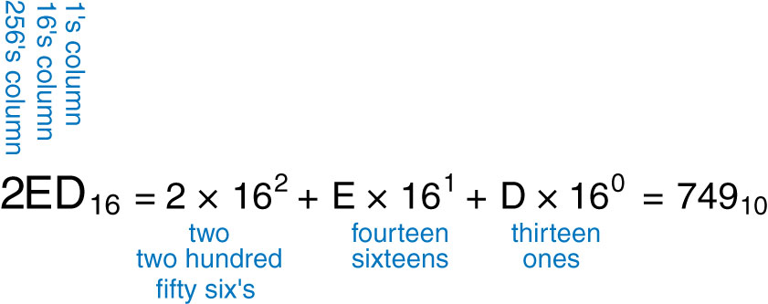
Figure 1.6 Conversion of a hexadecimal number to decimal

Slide 7
Hexadecimal Numbers
Hex Digit | Decimal Equivalent | Binary Equivalent | Octal Equivalent
0 | 0 | 0000 | 0
1 | 1 | 0001 | 1
2 | 2 | 0010 | 2
3 | 3 | 0011 | 3
4 | 4 | 0100 | 4
5 | 5 | 0101 | 5
6 | 6 | 0110 | 6
7 | 7 | 0111 | 7
8 | 8 | 1000 | 10
9 | 9 | 1001 | 11
A | 10 | 1010 | 12
B | 11 | 1011 | 13
C | 12 | 1100 | 14
D | 13 | 1101 | 15
E | 14 | 1110 | 16
F | 15 | 1111 | 17
Copyright © 2007 Elsevier

Slide 8
Number System Conversions
 | Convert To:
Convert From: | Binary | Octal | Hexadecimal | Decimal
Binary | X | Substitution | Substitution | Summation
Octal | Substitution | X | Substitution | Summation
Hexadecimal | Substitution | Substitution | X | Summation
Decimal | Division | Division | Division | X
Division: Divide a number of larger base by the lower base and assign the remainder as the LSB up to the MSB.
Summation: Use the positional numbering system to multiply the digit by the power of the position (A_{n}b^{n} + A_{n-1}b^{n-1} + … + A₁b¹+ A₀b⁰ = ).
Substitution: The Rule of Threes (for binary ⬄ octal) and the Rule of Fours (for binary ⬄ hexadecimal)

Slide 9
Bits, Bytes, Nibbles…
Bits
Bytes & Nibbles
Bytes
Copyright © 2007 Elsevier

Slide 10
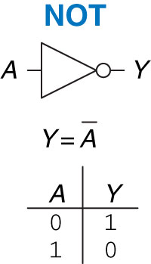
Figure 1.12 NOT gate

Slide 11
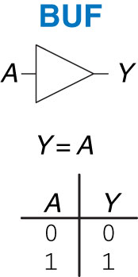
Figure 1.13 Buffer

Slide 12
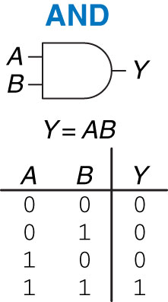
Figure 1.14 AND gate

Slide 13
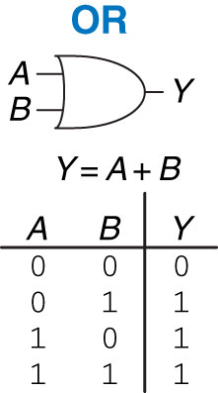
Figure 1.15 OR gate

Slide 14
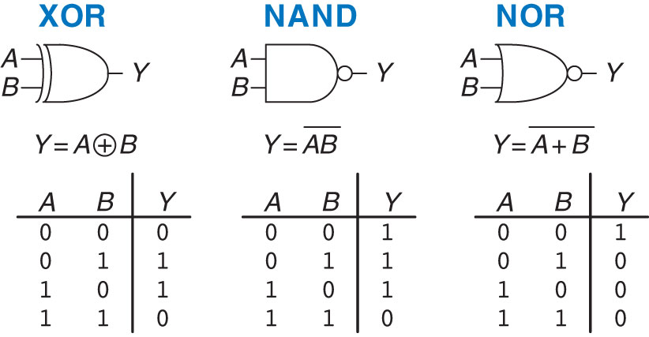
Figure 1.16 More two-input logic gates

Slide 15
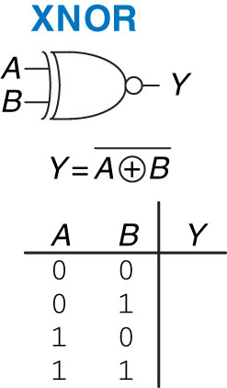
Figure 1.17 XNOR gate

Slide 16
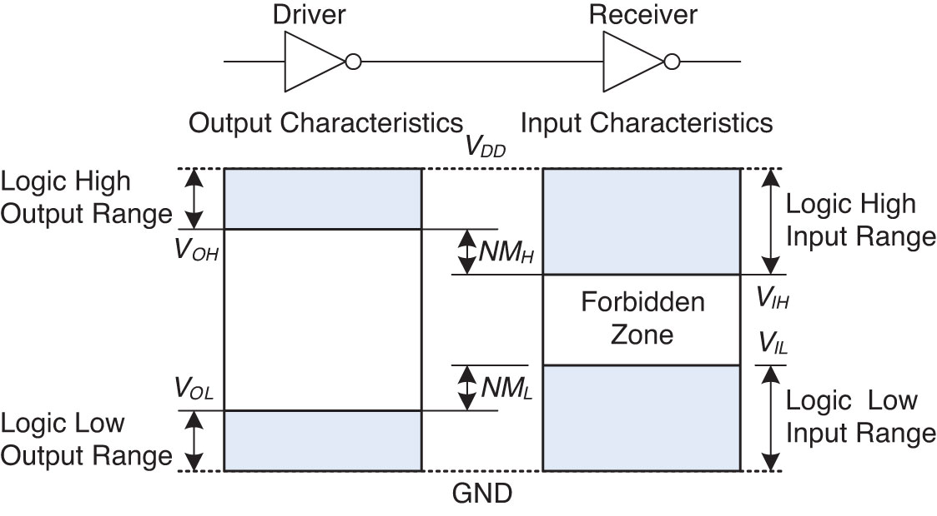
Figure 1.23 Logic levels and noise margins

Slide 17
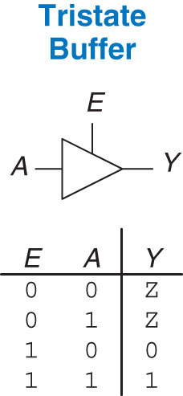
Figure 2.40 Tristate buffer

Slide 18
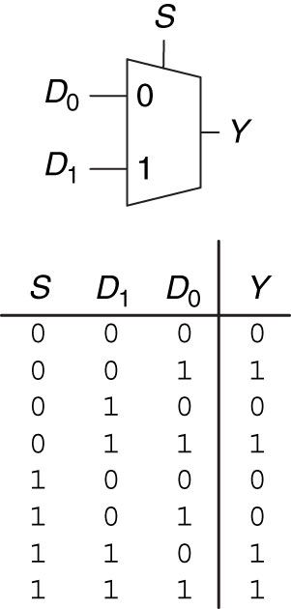
Figure 2.54 2:1 multiplexer symbol and truth table

Slide 19
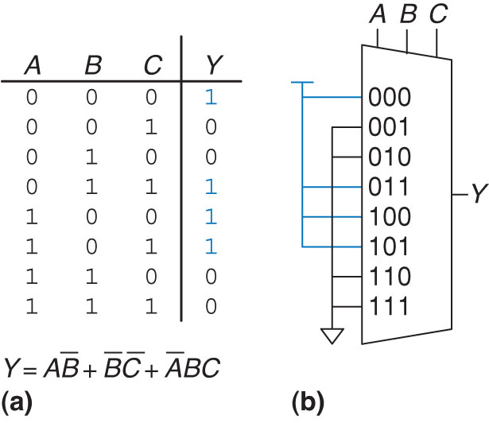
Figure 2.61 Alyssa’s circuit: (a) truth table, (b) 8:1 multiplexer implementation

Slide 20
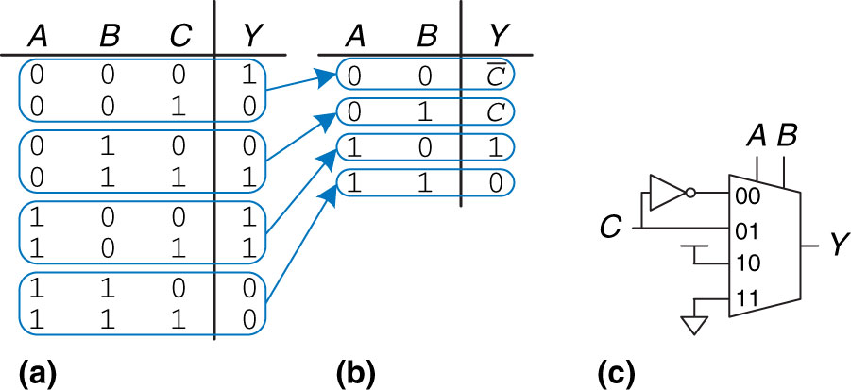
Figure 2.62 Alyssa’s new circuit

Slide 21
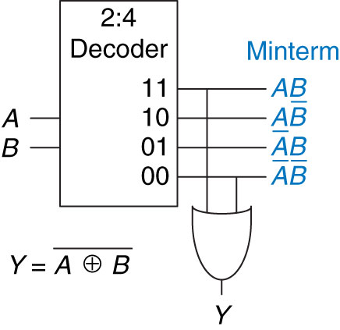
Figure 2.65 Logic function using decoder

Slide 22
Figure 2.65 Logic function using decoder

Slide 23
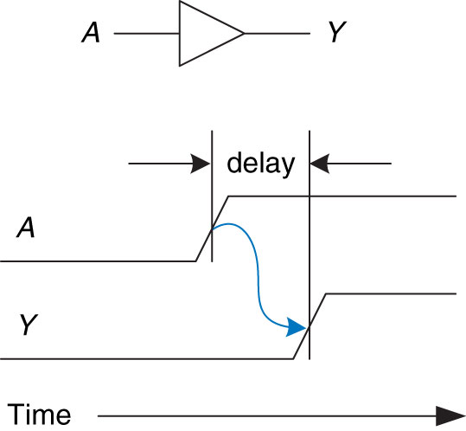
Figure 2.66 Circuit delay

Slide 24
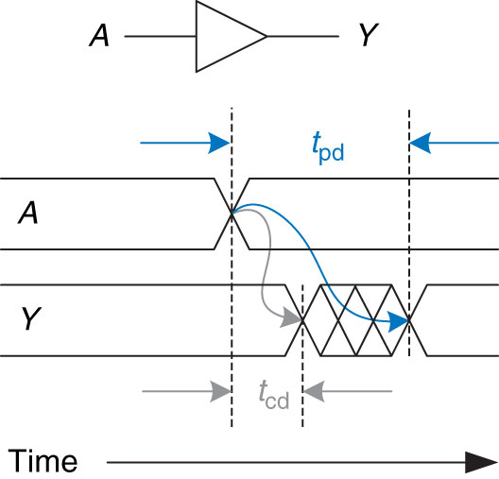
Figure 2.67 Propagation and contamination delay

Slide 25
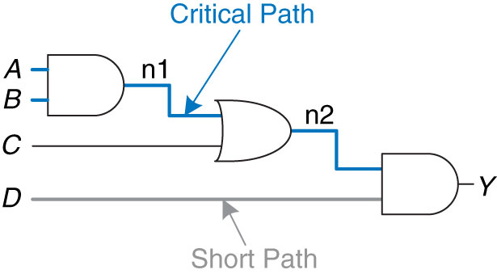
Figure 2.68 Short path and critical path

Slide 26
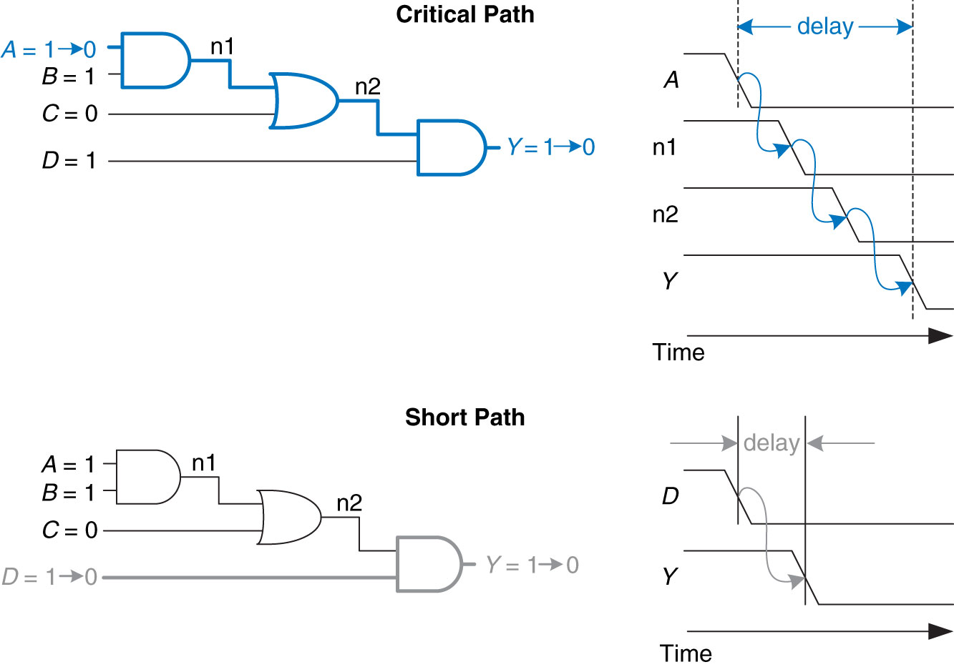
Figure 2.69 Critical and short path waveforms

Slide 27
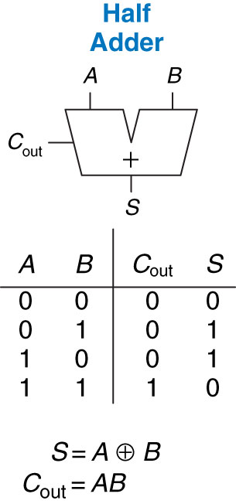
Figure 5.1 1-bit half adder

Slide 28
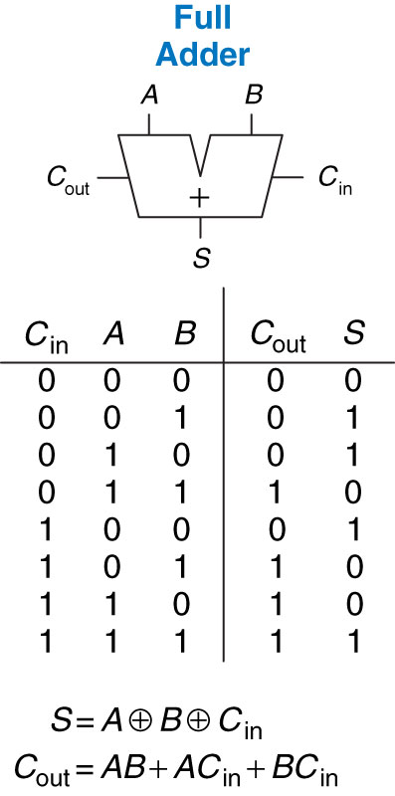
Figure 5.3 1-bit full adder

Slide 29
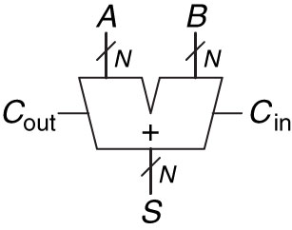
Figure 5.4 Carry propagate adder

Slide 30
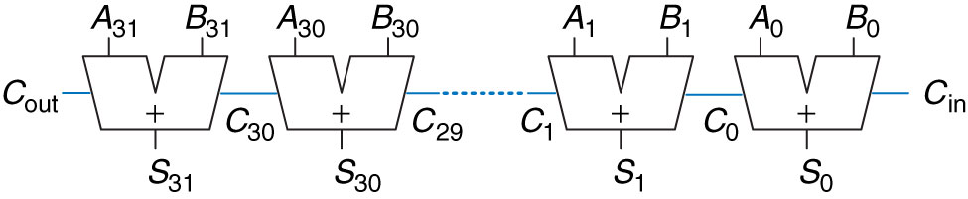
Figure 5.5 32-bit ripple-carry adder

Slide 31
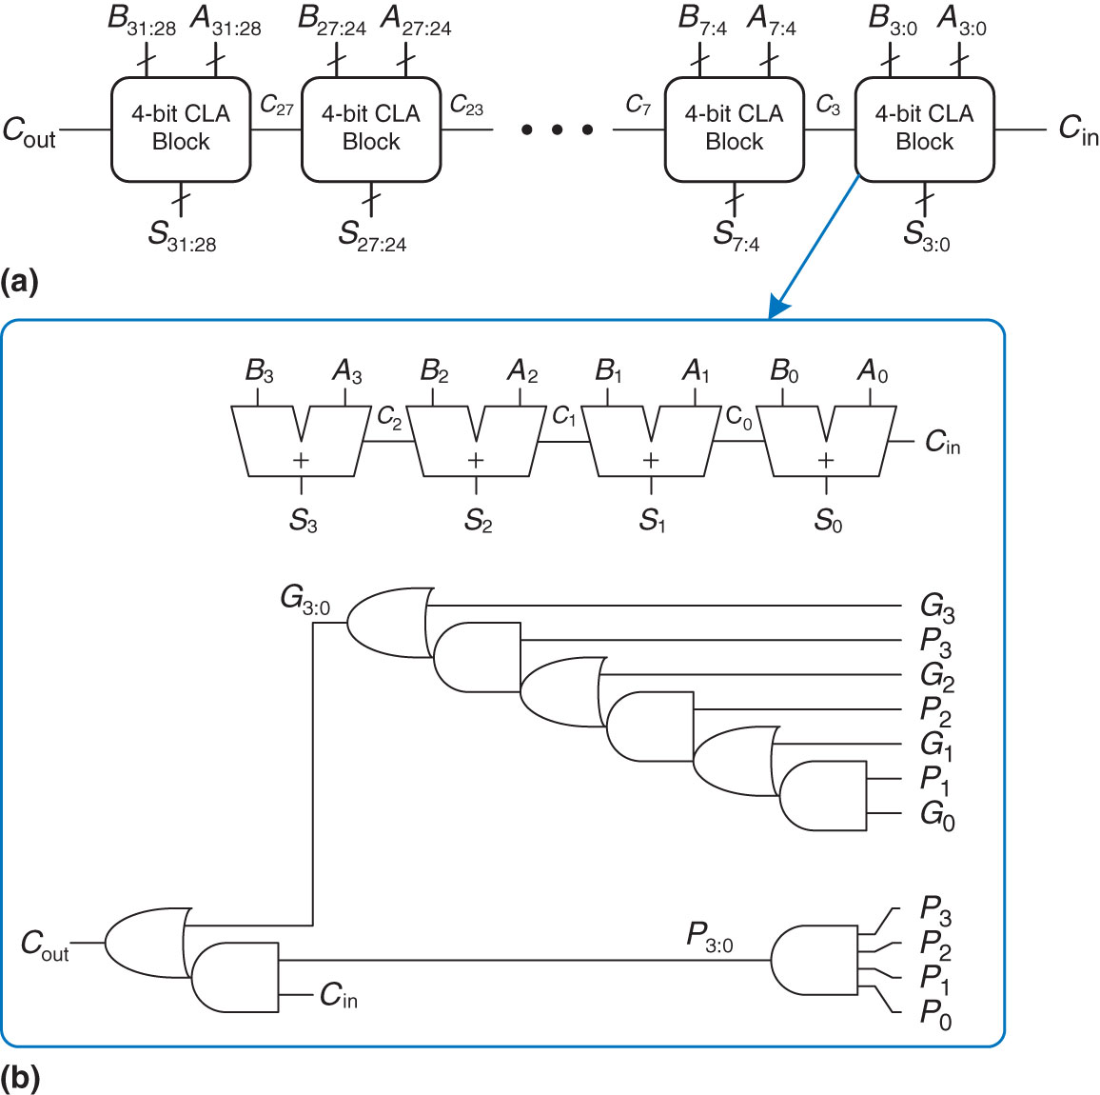
Figure 5.6 (a) 32-bit carry-lookahead adder (CLA), (b) 4-bit CLA block

Slide 32
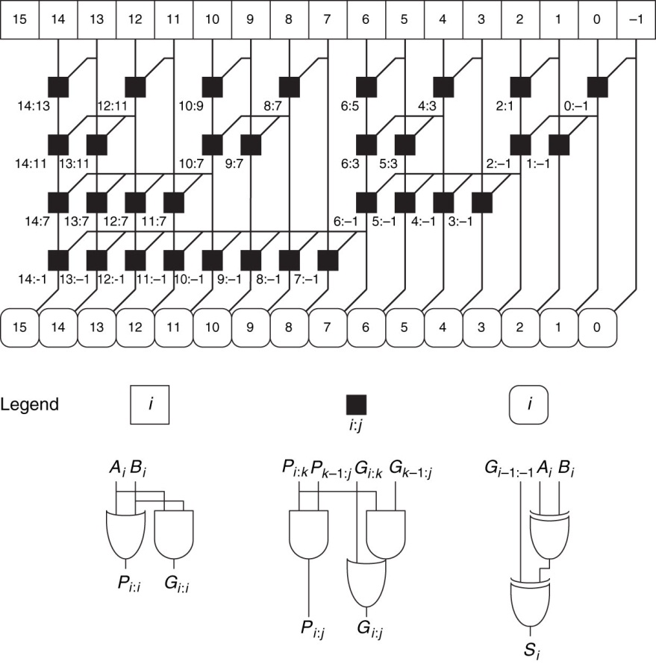
Figure 5.7 16-bit prefix adder

Slide 33
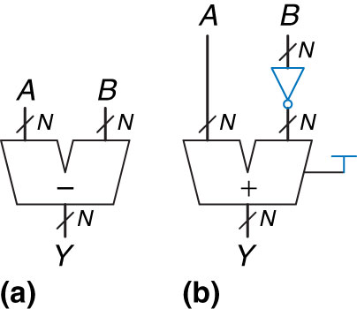
Figure 5.9 Subtractor: (a) symbol, (b) implementation

Slide 34
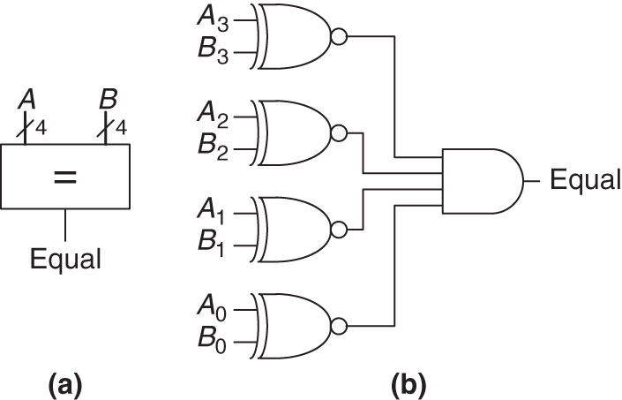
Figure 5.11 4-bit equality comparator: (a) symbol, (b) implementation

Slide 35
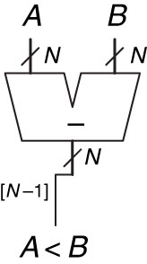
Figure 5.12 N-bit magnitude comparator

Slide 36
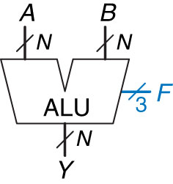
Figure 5.14 ALU symbol

Slide 37
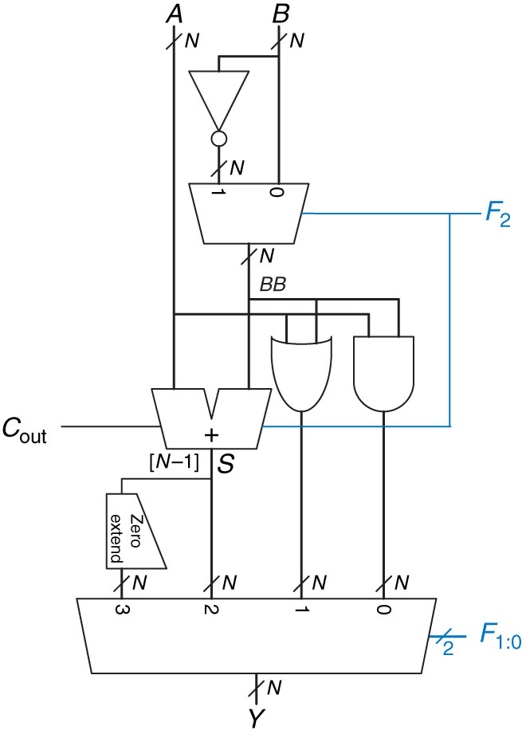
Figure 5.15 N-bit ALU

Slide 38
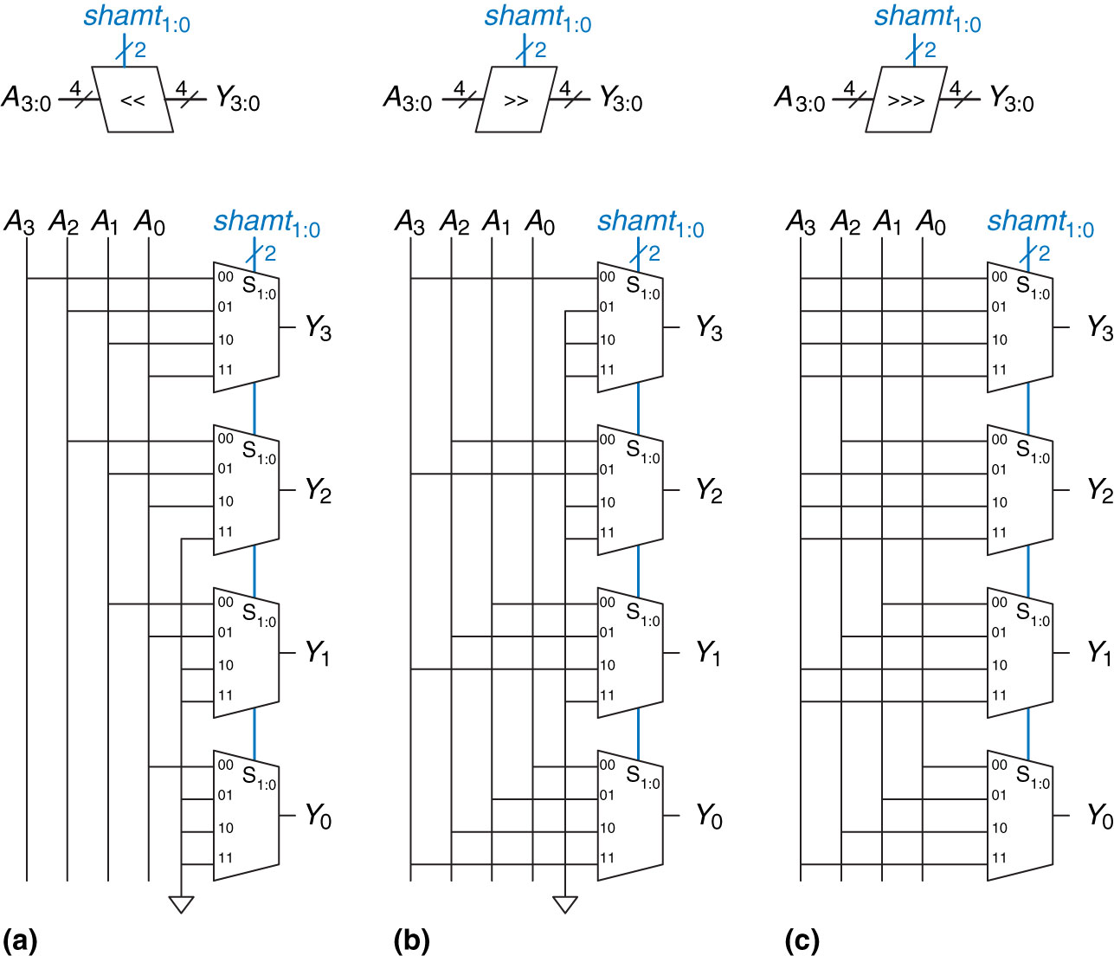
Figure 5.16 4-bit shifters: (a) shift left, (b) logical shift right, (c) arithmetic shift right

Slide 39
Extra Instruction (EI)
Maj Jeffrey Falkinburg
2E46E
Office: 333-9193
M1
ECE 281 – 2F44
T1
M2
ECE 281 – 2F44
T2
M3
ECE 463 – 2G2
T3
ECE 383 – 2E48A
M4
ECE 463 – 2G2
T4
ECE 383 – 2E48A
Available
M5
T5
Sometimes Available
M6
ECE 383 – 2E48A
T6
Always Unavailable
M7
ECE 383 – 2E48A
T7

Slide 40

40

